Slide 1
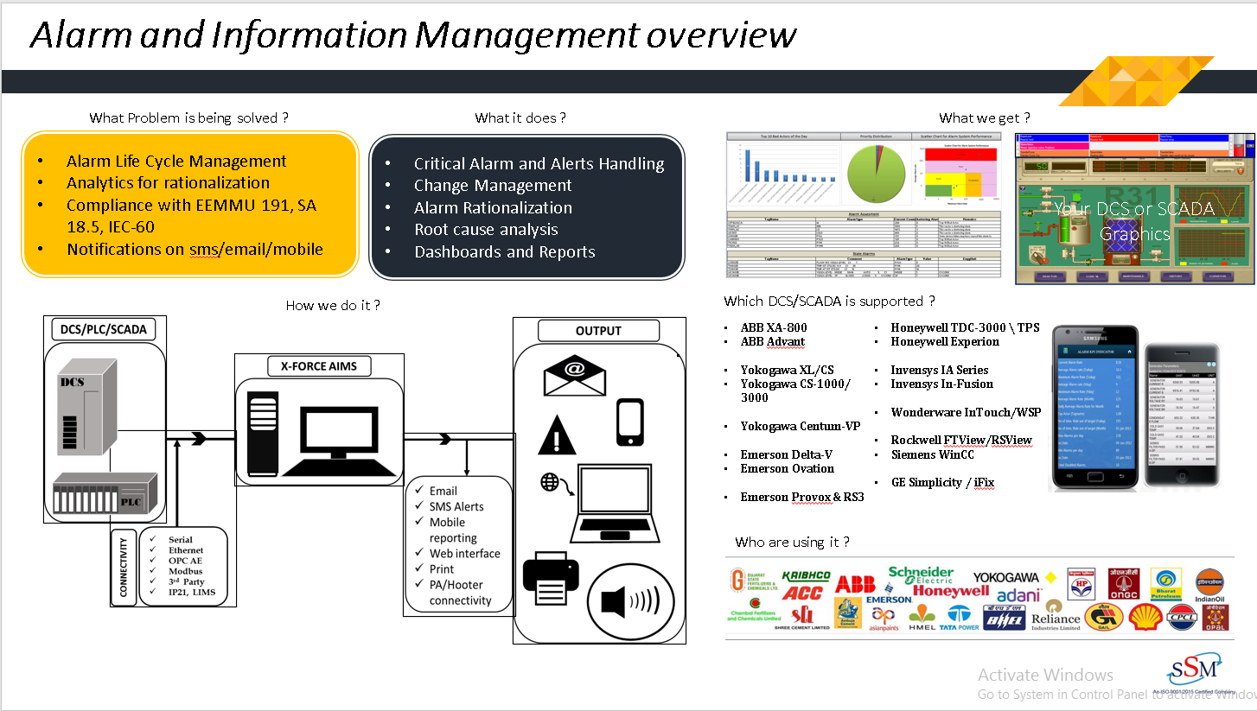

Slide 2
X-Force AIMS
X-Force AIMS software has used cases in more than 500 installations all over India, in all major industries.
X-Force AIMS is a high-performance application, to meet all the alarm and report capturing and analysis requirements.
X-Force AIMS is a complete alarm, messages, event and report - handling package.

Slide 3
X-Force AIMS provides
Printer replacement
Alarm viewing and analysis
Analytics Dashboard
Web Enabled Alarms and Reporting
E-mail and mobile/SMS notifications
Mobile Reporting
Compliance report as per EEMUA 191 Guidelines

Slide 4
BENEFITS
It replaces Alarm and Log Report Printer by PC based system.
Quick alarms notification triggered when any kind of plant parameter is disturbed.
It has extended analysis tool to improve plant performance.
i.e. Most frequent alarms, Key performance indicator, standing alarms, chattering, Flood alarms,
Operator action & System alarm report.
Reduce nuisance alarms by up to 67 percent.
Improve production through put by 3 to 5 percent.
Improve operator competency, engagement, and situation awareness.
It gives various Notifications like SMS, Voice Message & Email
Enterprise Server Facilities to maintain site data and generate report.

Slide 5
What can I expect from AIMS?
Capture and store alarms for years reliably.
Support Mail system for automatic Report notification.
Synthesized Voice / Prerecorded voice notification over Speaker or public announcement system.
Alarm web portal for web based alarms and reports.
Automatic backup and archiving
Frequency Analysis and Duration analysis report scheduling for automatic report generation and notification to end users.
Provision for additional database columns like operator remarks.
Application failure or problem in system through Network messages and mail for easy administration.
Open Database (MS-SQL Server) to store data. ActiveX support for third party integration and website.
Connectivity with almost all type of systems that prints the alarms/Reports in one or other form.

Slide 6
Industrial Alarm System: CHALLENGES
A poorly performing alarm system compromises operator’s performance
CHALLENGES
Alarm Flood
Challenges
The situation where more alarms are received than can be physically addressed by a single console operator. 10 or more annunciated alarms in any 10-minute period per operator
Chattering Alarms
Alarms that repeat excessively in a short time interval. and may responsible for 10-60% of total alarm occurrences
Standing Alarms
Remain active even though the plant is operating normally. Usually caused by instrument faults, inappropriate alarm limit settings and out-of-service equipment.
Alarm Rationalization
Process of Alarm rationalization as per the EEMUA 191 and ANSI Guidelines. Top bad actors & Alarm Flood situations. Identify the action taken for any Improvement in Process
Poor configuration
If the concept of alarming a process point is so simple, then why do so many alarm system configurations end up as miserable failures?

Slide 7


Solutions with X-Force AIMS
Make a big impact with the globally proven solution
A
Enhance operator efficiency
Avoid alarm floods
Identify root causes
Eliminate nuisance alarms
B
Maximize profitability
Prevent damage to equipment
C
Reduce Risk
Injury to personnel
Environmental incidents

Slide 8
Develop Plant
Alarm Management
Standards & Philosophy
Collect Data
01
Change management
Collect different variables as primary and secondary depending on the kind of abnormal event and present the operator with collection of variables that are most important.
Even the most well-designed alarm system may not prevent problems if there is not strict control over access to configuration changes
02
Analyze
03
Implement
The operator analyze and take actions based on his experience to bring the variable to the target region
During the Implementation phase, the alarms in the control system are put into operation
04
Identify Enhancements
05
Verify Standards
Eliminating the top 10 or 20 of these alarms can help reduce the alarm load significantly. Identify the changes
06
Verify the alarm management standard to create a safer and more productive plant

Slide 9
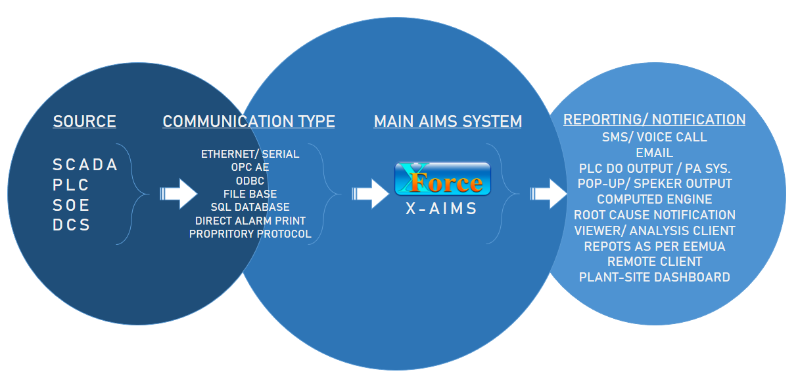
Outcome: Integration with X-Force AIMS
PIDS Integration
Yokogawa XL/CS
Emerson Delta-V
Emerson Ovation
LDS Integration
Yokogawa CS-1000/ 3000
Honeywell TDC-3000 \ TPS
Honeywell Experion
Emerson Provox & RS3
Invensys IA Series
Invensys In-Fusion
Yokogawa Centum-VP
All Major SCADA & PLC

Slide 10
HOW IT WORKS…
Alarms/Events flow
DCS
01-JUN-2022 10:12:00.120 TIC3005 Boiler Inlet water temperature HIGH PV=230.5 SP=230.0 2
01-Jun-2022 10:12:00.120
TIC3005
Boiler Inlet water Temperature
HIGH
230.5
230.0
Critical
Filter
Segregate
Date-Time Tag-name Comment Type Value Limit Priority
X-Force Alarm Management Database

Slide 11
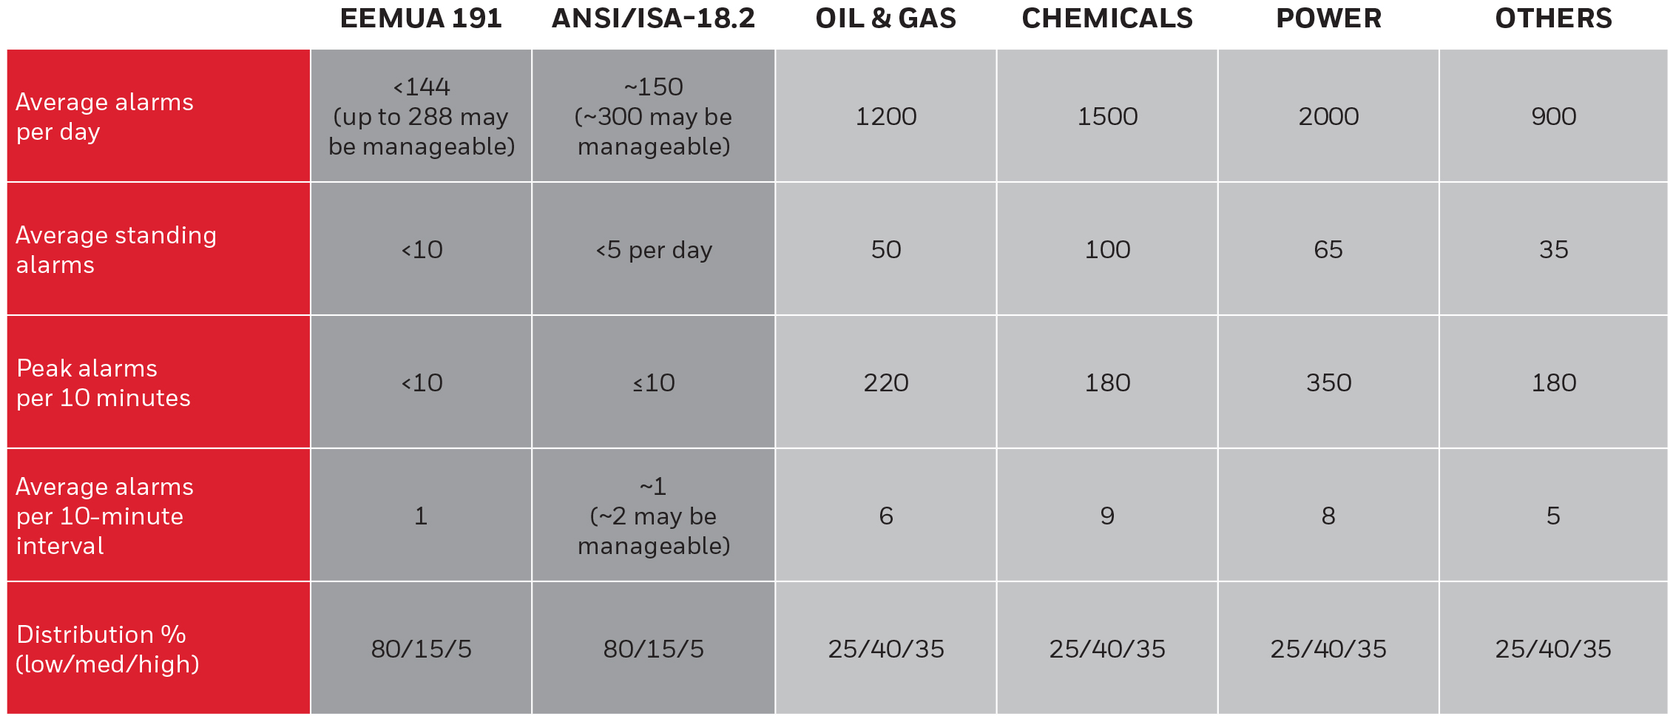
COMPLIANCE WITH STANDARDS & LOGIC ENGINE
KPI Standard as per EEMUA 191 Guidelines

Slide 12
LOGIC ENGINE EXAMPLE
Sequence of Events Screen
01-JAN-201210:20:00 P-1003 LUBE OIL PUMP STOP
01-JAN-2012 10:22:10 PI-5003 LUBE OIL PRESSURE LOW
01-JAN-2012 10:23:20 T-1003 LUBE OIL TEMP HIGH
01-JAN-2012 10:26:25 PIC-5001 SET POINT SP=100 OLD=90
01-JAN-201210:27:33 TI-1002 COMP TEMP HIGH
01-JAN-2012 10:27:34 COMPRESSOR LIKELY TO TRIP
01-JAN-201210:35:50 TI-1002 INLET TEMPERATURE HIGH HIGH
01-JAN-2012 10:35:53 COMPRESSOR TRIP
01-JAN-2012 10:35:54 COMPRESSOR TRIP-Due to P-1003
01-JAN-2012 10:36:00 PIC-5001 PRESSURE LOW
01-JAN-2012 10:36.45 FIC-5001FLOW LOW
01-JAN-2012 10:37:01 PIC-5001 PRESSURE LOW LOW
01-JAN-2012 10:37:10 FIC-5001 FLOW LOW LOW
Time : 01-JAN-2012 10:27:34
Please start both inlet cooling pump and raise pressure
after TI-1002 comes normal.
Compressor Likely to Trip
Generate
Hooter/PA System
Time : 01-JAN-2012 10:35:54
Root cause of Compressor Trip : P-1003 Lube Oil Pump Stop
Compressor Trip due to P-1003 Lube oil pump stop
Generate
SMS
Generate
email

Slide 13
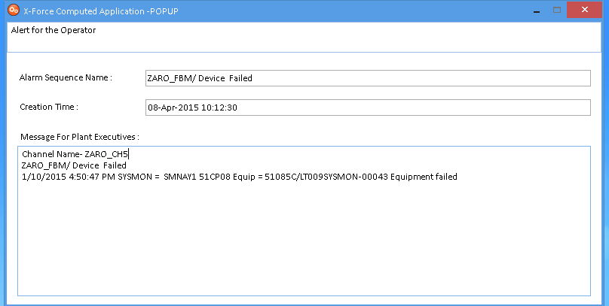
OPERATOR GUIDANCE MESSAGE
Screen Pop-up

Slide 14

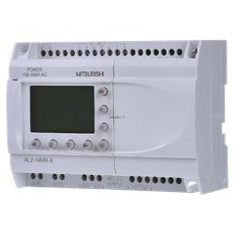

Hooter Connectivity
AIMS
Ethernet
Adam Module /
Controller / PLC
(Modbus TCP)
Digital Output

Slide 15
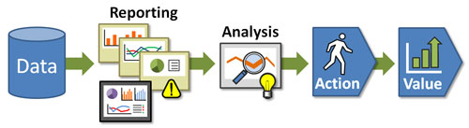
ANALYTICS AND REPORTING
ANALYTICS AND REPORTING
Process Alarms Analysis
Key Performance Indicator
Frequency Analysis
Alarm Rate
Duration Analysis Report
Alarm Tree Map
Standing Alarms
Severity v/s Frequency Chart
Chattering Alarm Report
Duplication Alarm Report
Alarm Flood Report
Consequential Alarm Report
API Scatter Chart Report
Operator Action Reports
System Messages Logs
Configuration Analysis

Slide 16
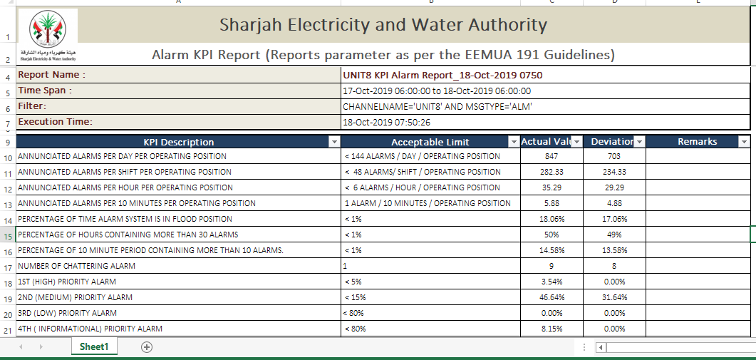
Sample of Excel Reports
ALARM RATIONALIZATION WITH ASSESSMENT REPORT

Slide 17
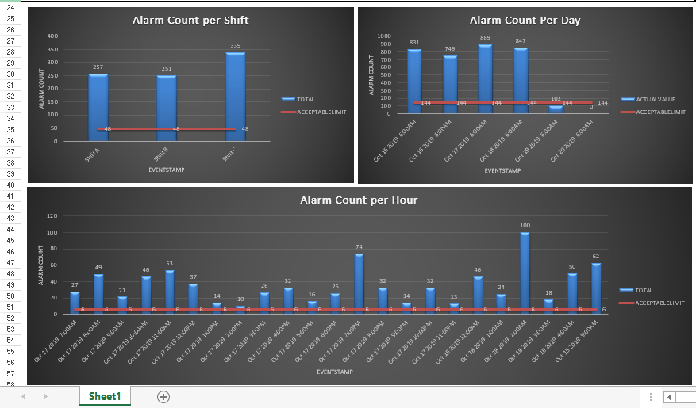
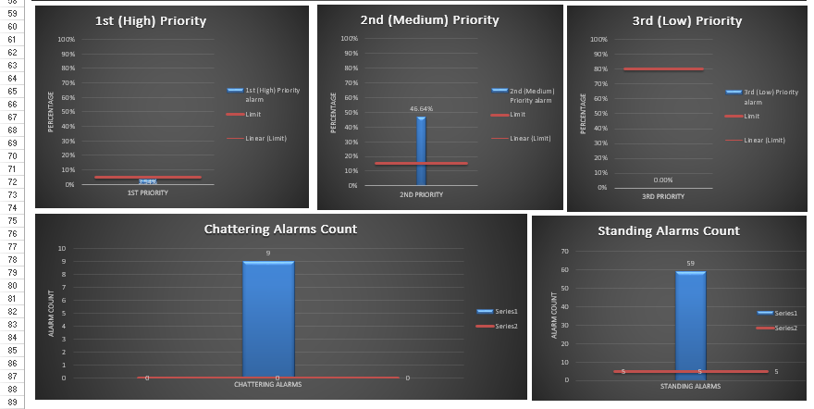
ALARM RATIONALIZATION WITH ASSESSMENT REPORT

Slide 18
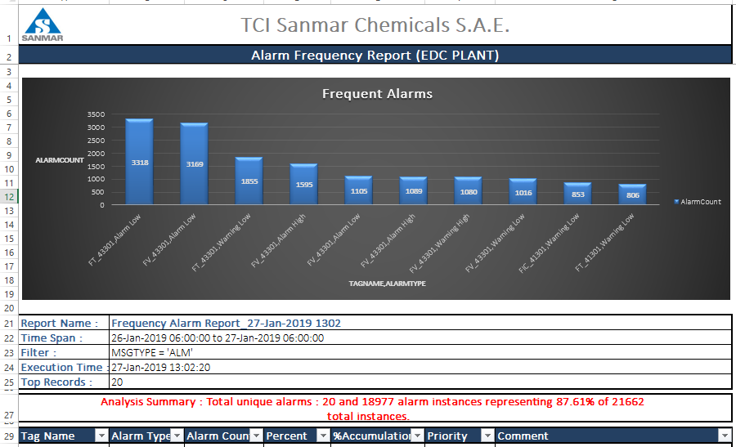
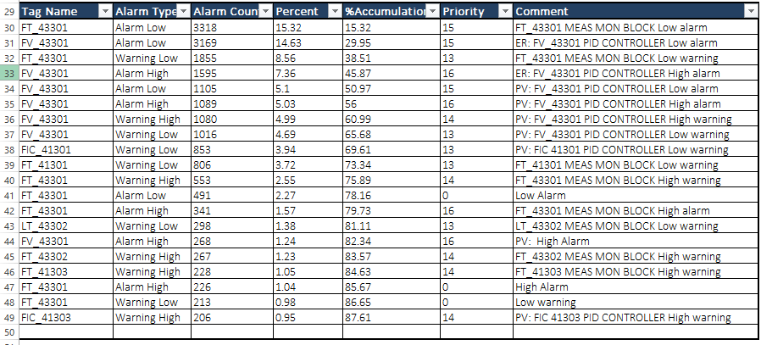
Frequency Alarm Analysis - Report

Slide 19
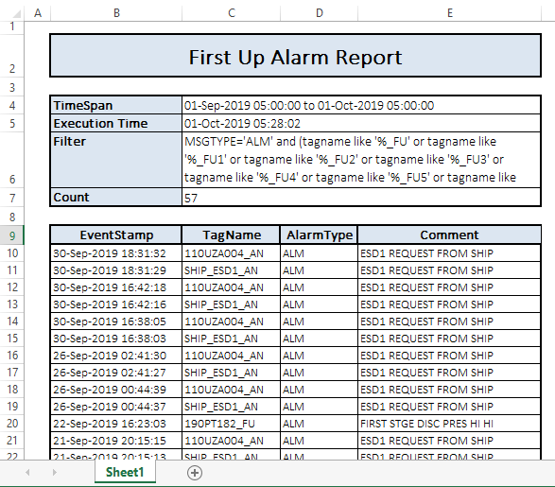
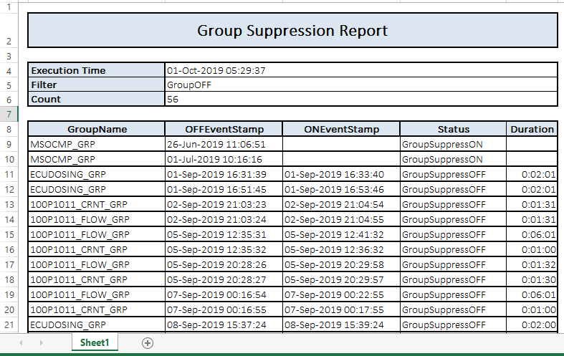
Sample of Excel Reports
First Up Alarm Report
Group Suppression Report

Slide 20
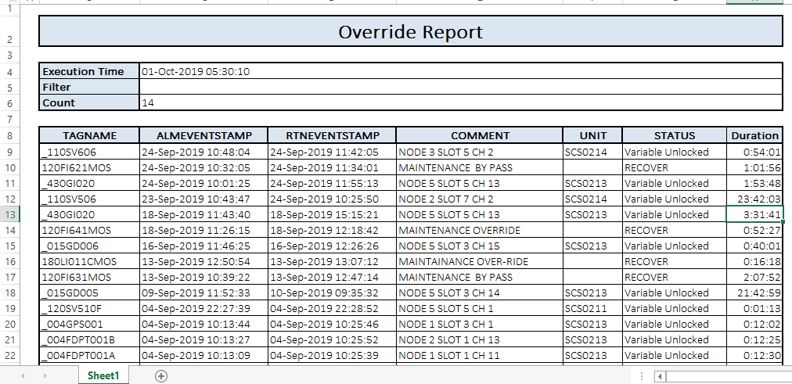
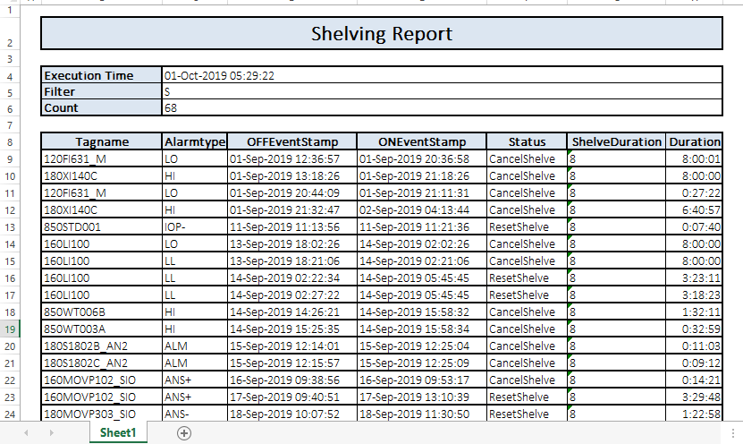
Sample of Excel Reports
Override Report
Alarm Shelving Report

Slide 21
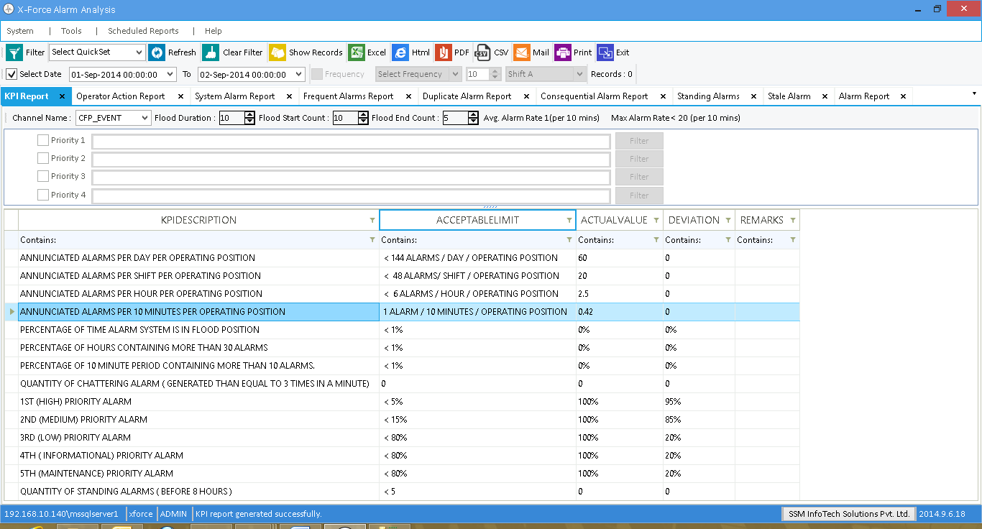
X-Force Alarm Analysis
KEY PERFORMANCE INDICATOR

Slide 22
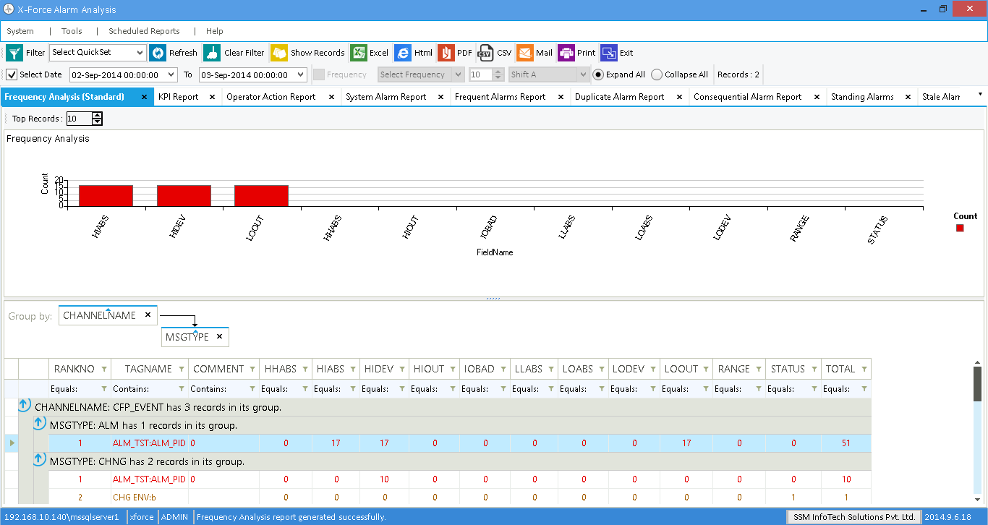
REPORT - FREQUENCY ANALYSIS

Slide 23
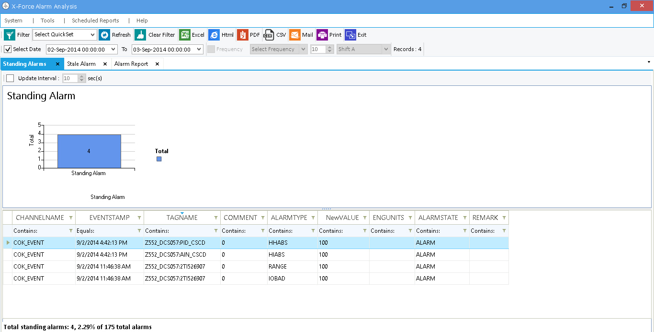
REPORT - STANDING ALARMS

Slide 24
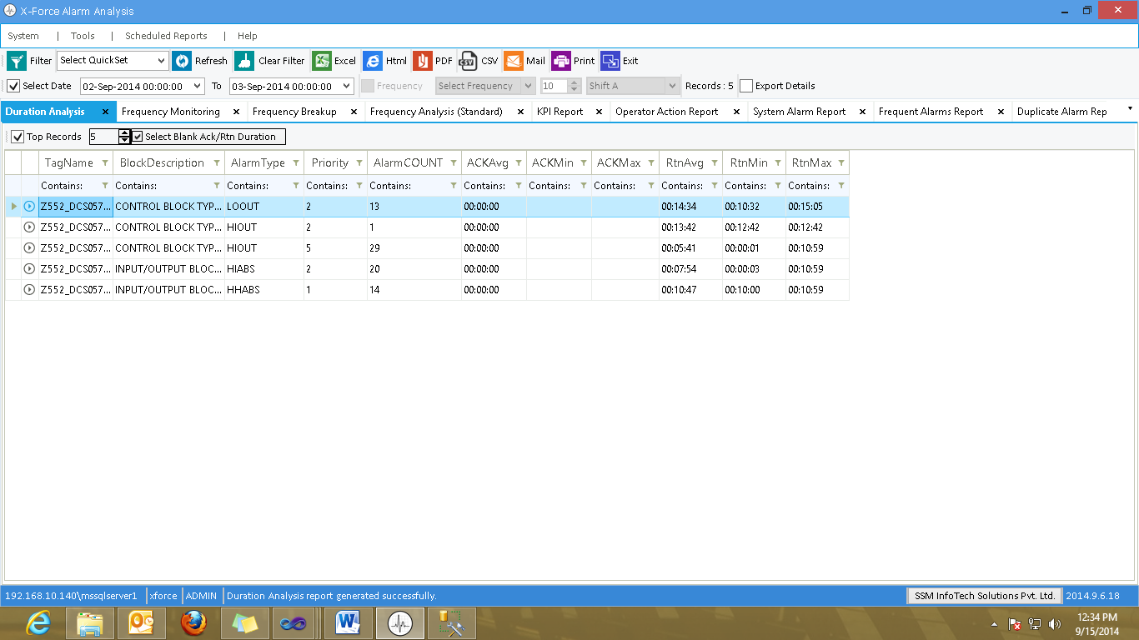
REPORT - DURATION ANALYSIS

Slide 25
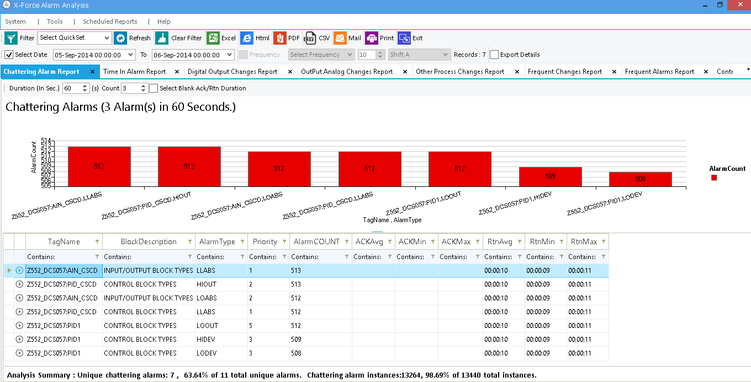
REPORT - CHATTERING ALARM

Slide 26
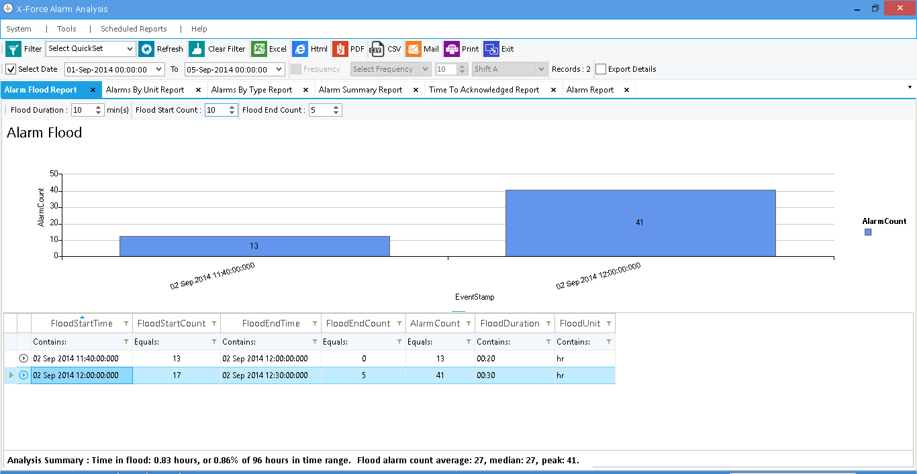
REPORT - ALARM FLOOD

Slide 27
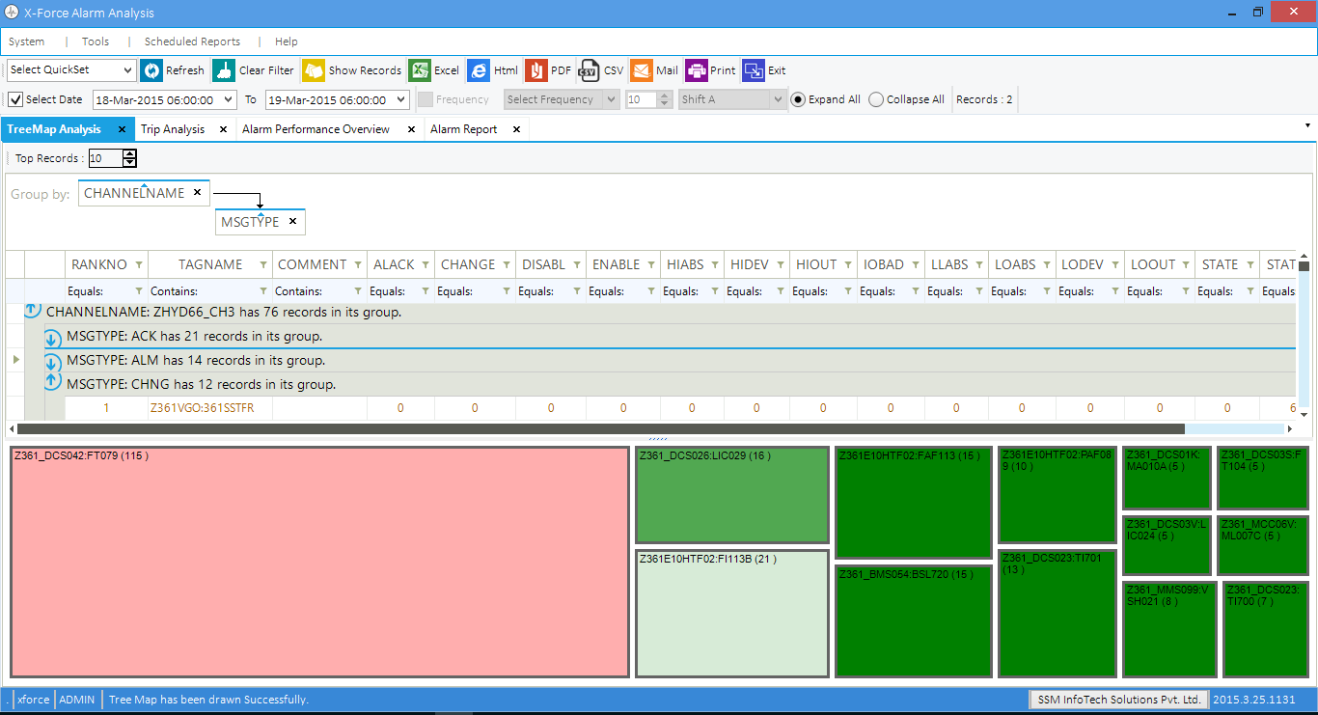
REPORT - TREE MAP ANALYSIS

Slide 28
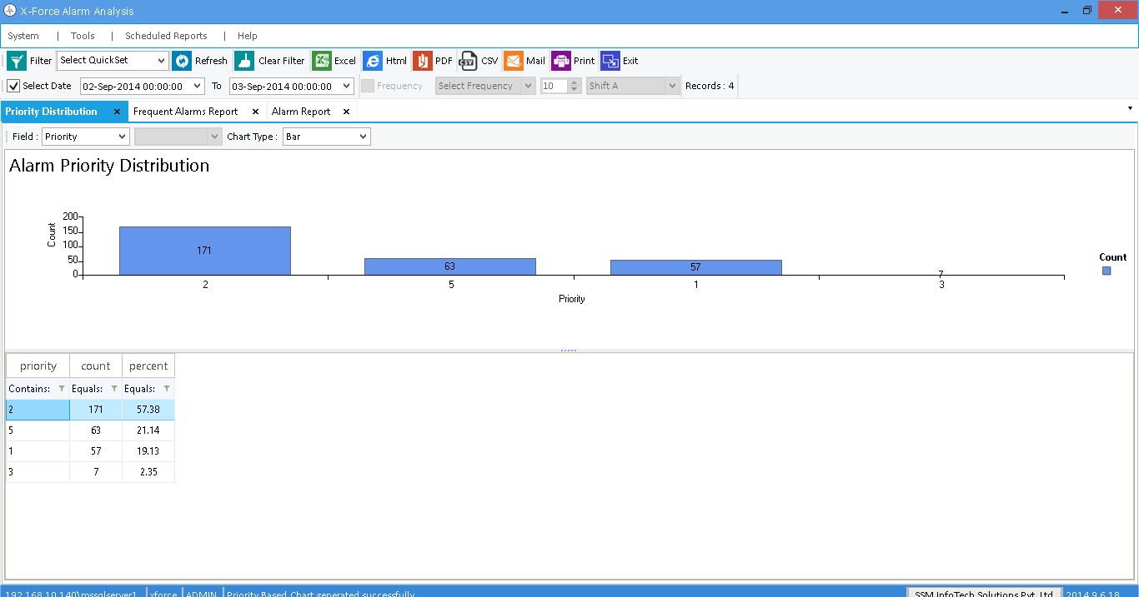
REPORT - SEVERITY V/S FREQUENCY CHART

Slide 29
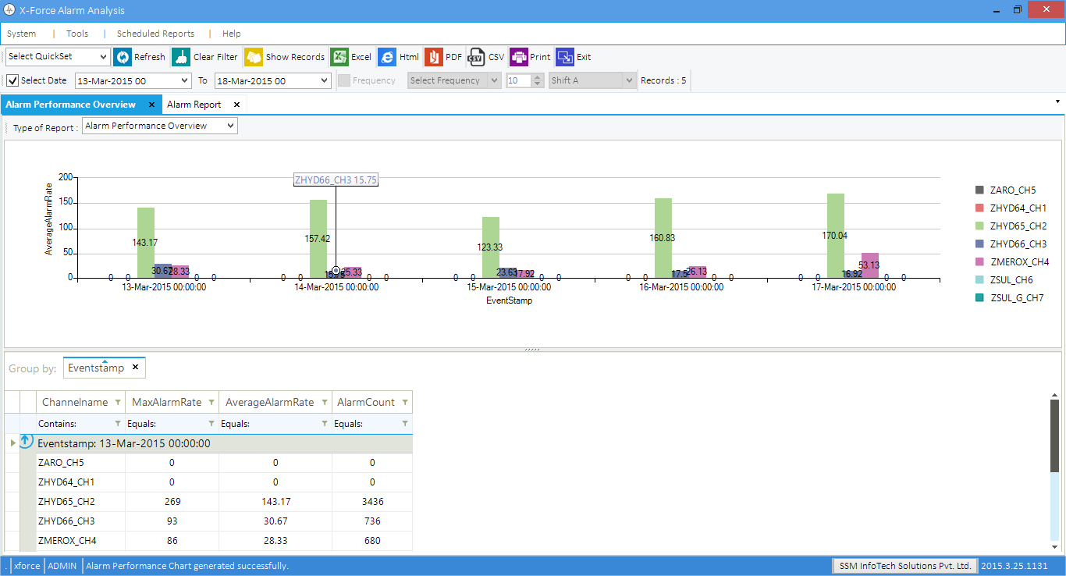
REPORT - API SCATTER CHART – WEEKLY

Slide 30
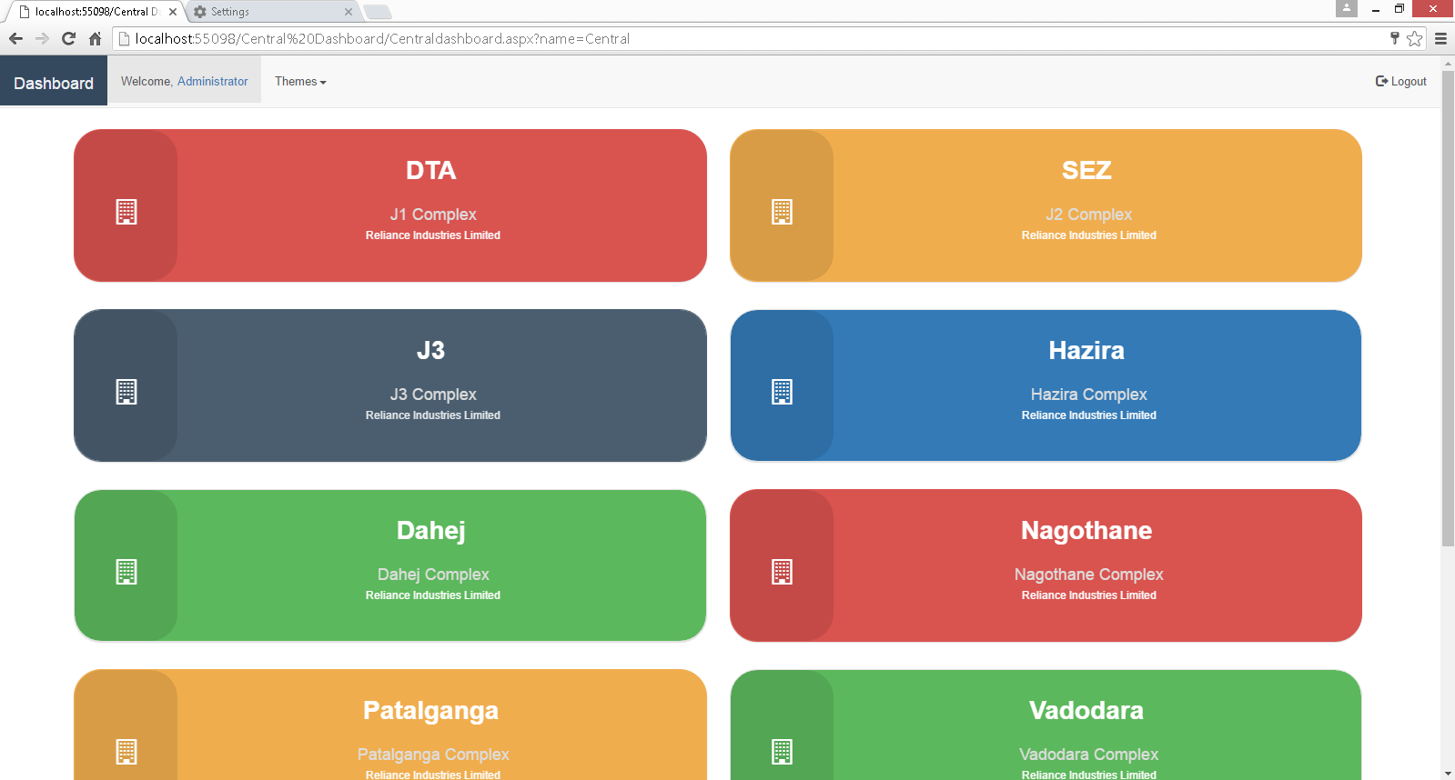
Web Analytical Dashboard :
(Site KPI / Plant Dashboard / Daily Dashboard / Weekly Dashboard / Monthly Dashboard)
SITE KPI DASHBOARD
All Location’s accessibility at single click- Centralized dashboard for Head Office

Slide 31
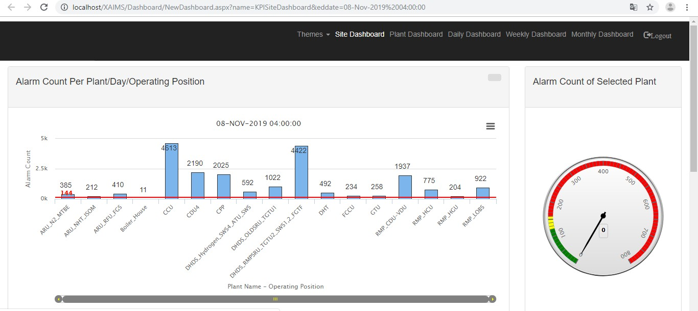
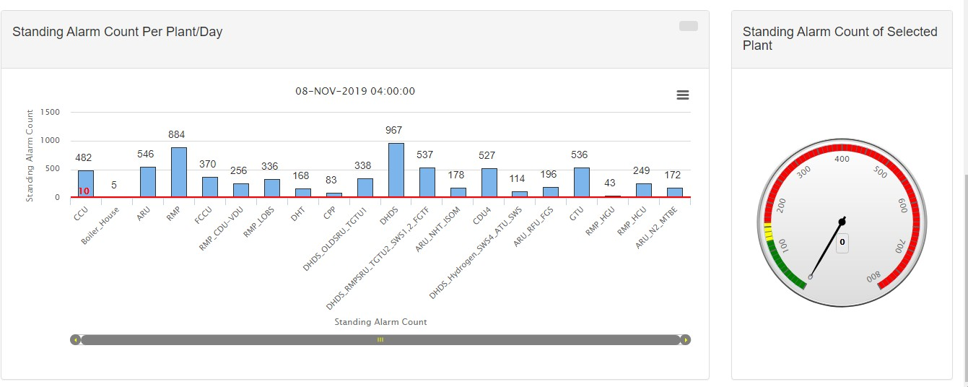
Web Analytical Dashboard :
(Site KPI / Plant Dashboard / Daily Dashboard / Weekly Dashboard / Monthly Dashboard)
SITE KPI DASHBOARD : Plant wise
Alarm Count per Plant/Day/Operating Position
Standing Alarm Summary (Site)

Slide 32
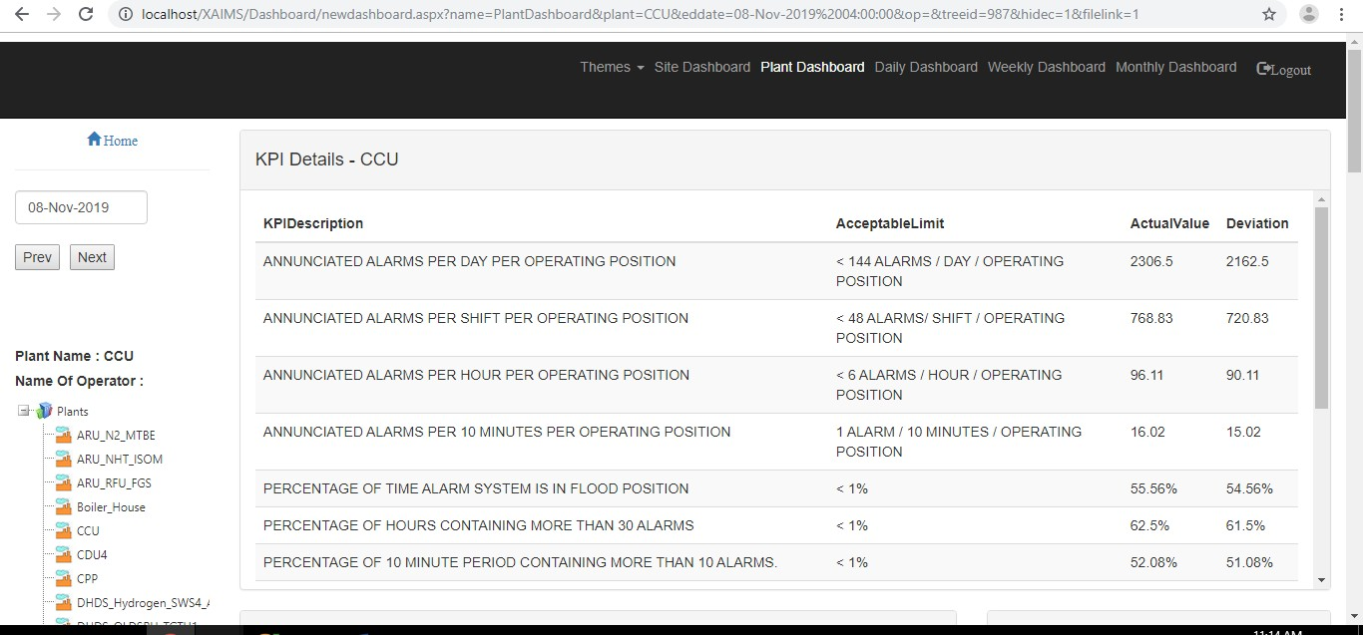
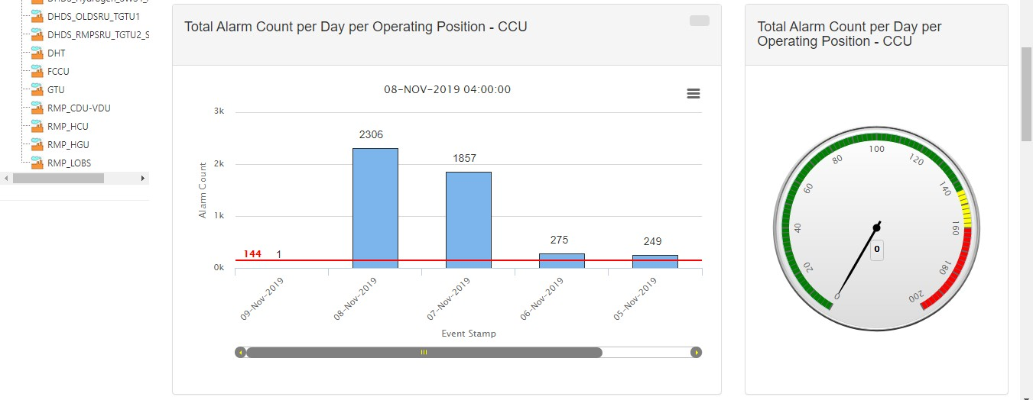
Web Analytical Dashboard : Screens
PLANT DASHBOARD
KPI Details

Slide 33
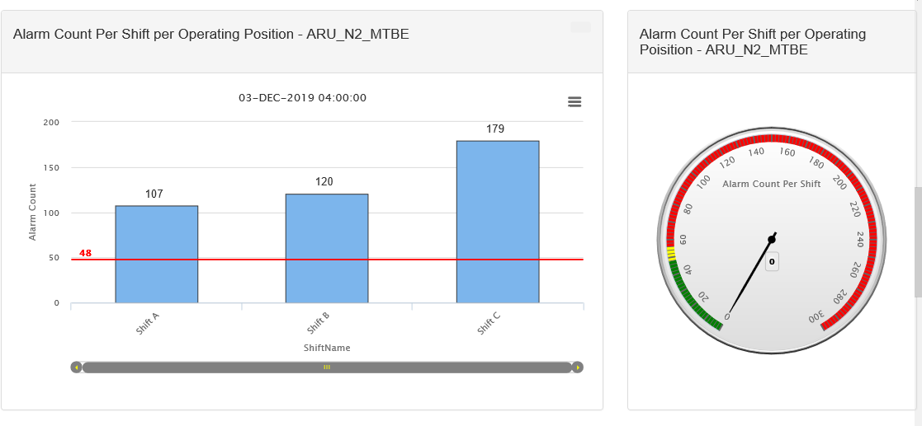
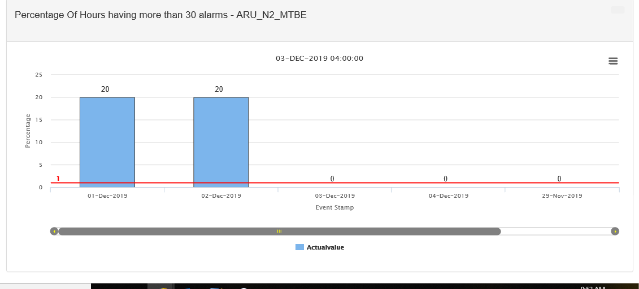
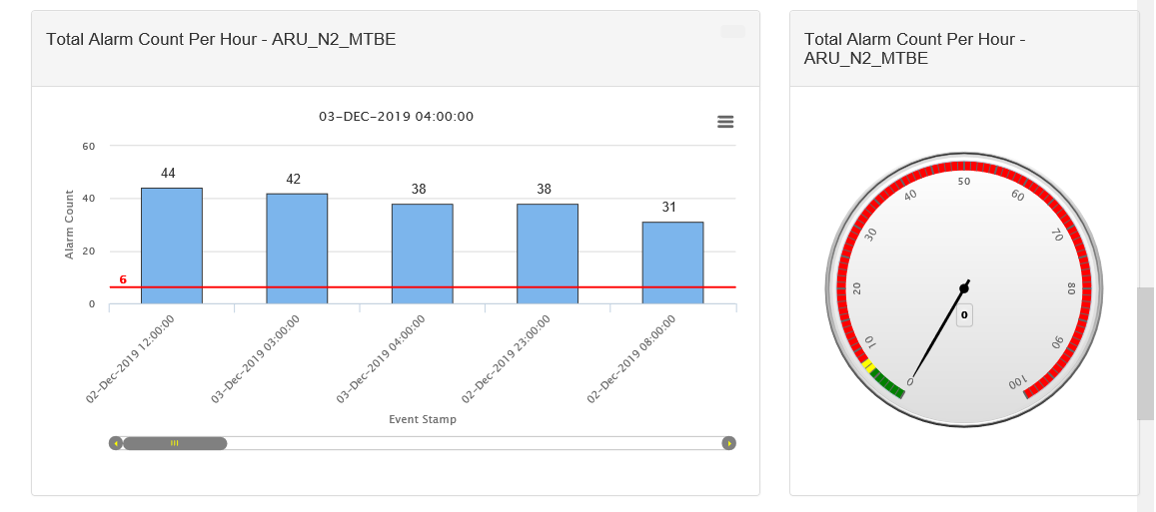
Web Analytical Dashboard : Screens
PLANT DASHBOARD
Alarm Count Per Shift Per Operating Position
Percentage of hours having more than 30 alarms
Total Alarm Count per Hour

Slide 34
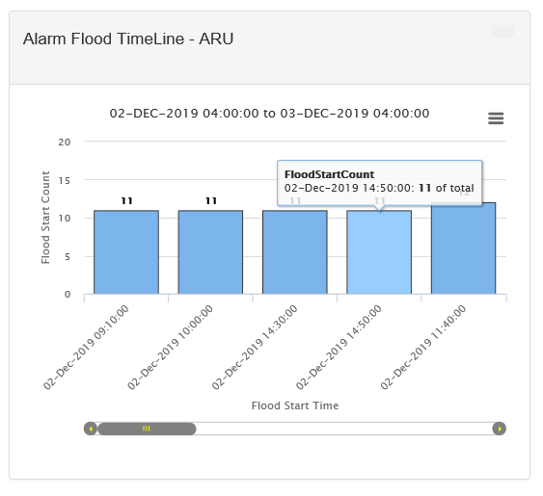
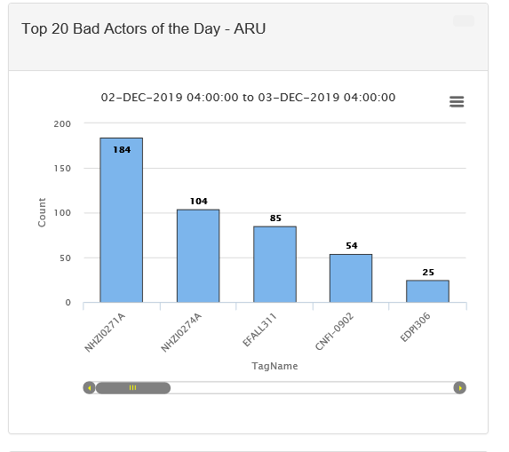
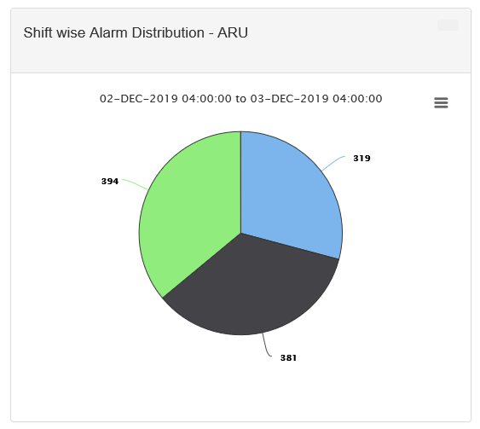
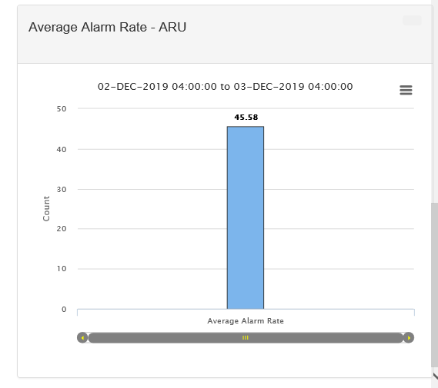
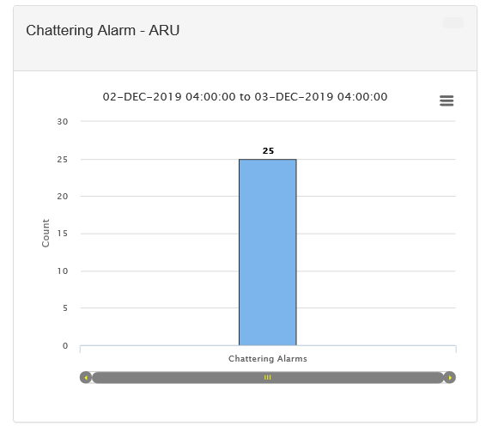

Web Analytical Dashboard : Screens
DAILY DASHBOARD
Alarm Flood Timeline
Top 20 Bad actors for the Day
Shift Wise Alarm Distribution
Average Alarm Rate
Chattering Alarms
Standing Alarms

Slide 35
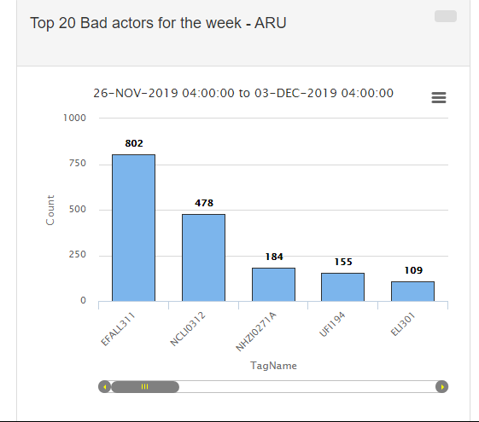
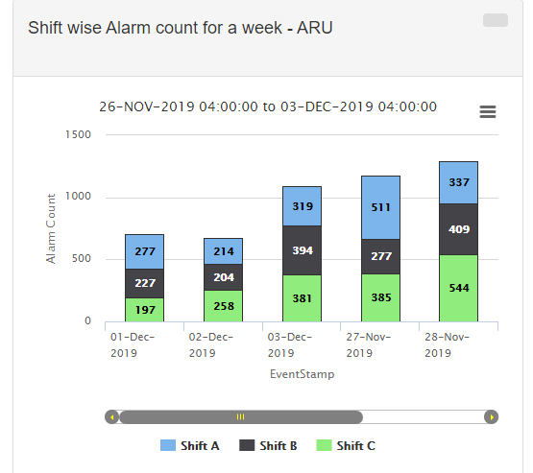
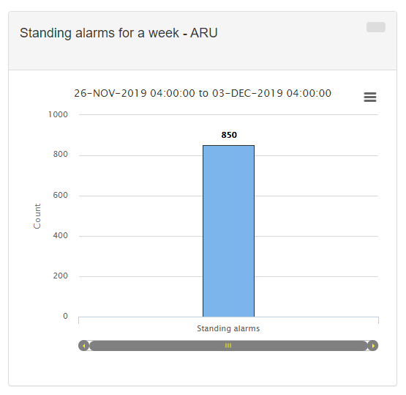
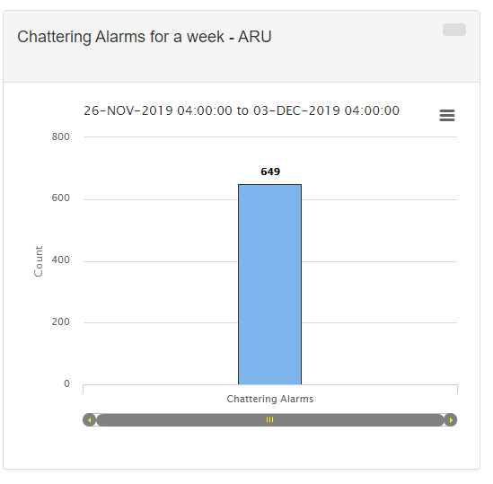
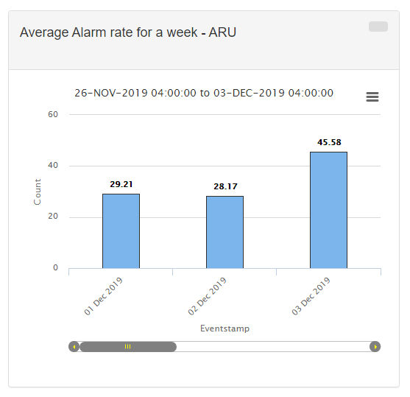
Web Analytical Dashboard : Screens
WEEKLY DASHBOARD
Shift wise Alarm Count for the week
Standing Alarm For the Week
Top 20 Bad actors for the week

Slide 36
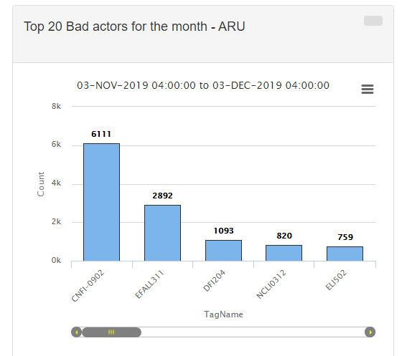
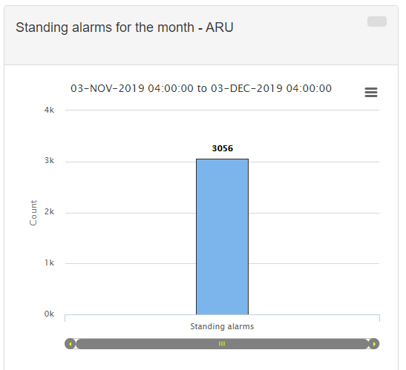
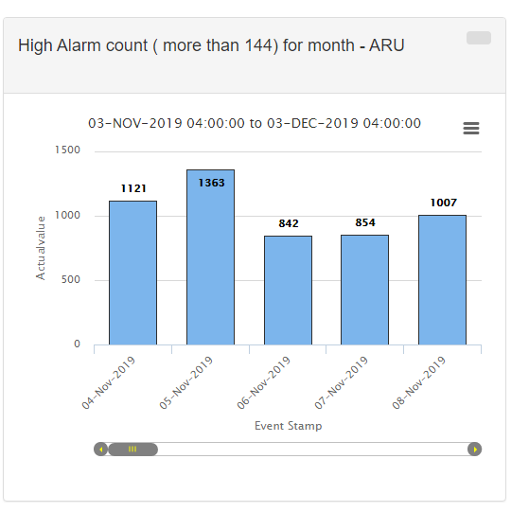
Web Analytical Dashboard : Screens
MONTHLY DASHBOARD

Slide 37
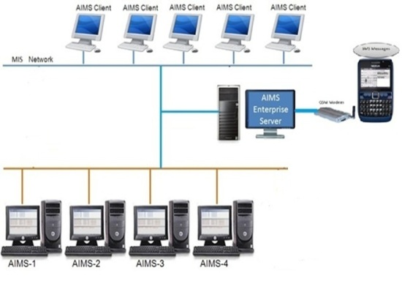
Reliance Industries – Plant / Site / Central Enterprise
Reliance Industries – Plant / Site / Central Enterprise
5 Sites across India
120 Plant level systems
Integrate with 20 different Control systems
Reliance Head Office
HMD
VMD
NMD
DMD
PMD

Slide 38


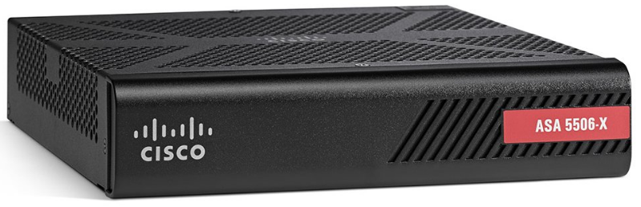
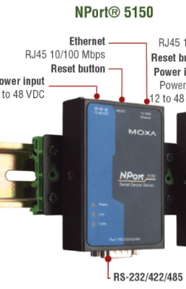

Live Connectivity : Scenario
Case-1
Case-2
Case-3
Case-4
DCS
DCS
DCS
DCS
At DCS USB to Serial DB9 Converter >>
(At AIMS) DB9 COM Port
At DCS Ethernet Switch to AIMS Firewall (By using AIMS Cisco Firewall)
At DCS Firewall to AIMS Firewall (Both Firewall)
At DCS Ethernet S/W to Serial converter >> AIMS COM Port
Firewall
Only Serial DB9 Communication
OPC / ODBC
Ethernet to Serial
AIMS Firewall
AIMS Firewall
COM-1
X-FORCE AIMS
X-FORCE AIMS
X-FORCE AIMS
X-FORCE AIMS
(Modules)
(Modules)
(Modules)
(Modules)

Slide 39
Do this system answer my Question?
Can I replace proprietary / Old age Control room printers?
Can I handle too many alarms happening at a time?
Can I increase the storage to my expectation, my SCADA / DCS has limited storage (5000 alarms)?
Can I view and analyse alarms and events remotely, avoid presence in the control room?
Can I archive alarms and event messages indefinitely?
Can I see alarms from different systems in one pane?
Can I selectively print alarms to explain the reasons of last breakdown to management?
Can I use my browser to see Alarms and reports?
Can I do without the help (permission) of the SCADA / DCS vendor?
The answer to all above is YES

Slide 40
Summary
This is a perfect solution for storage, visualization, Analysis and Optimization of Alarms / messages and reports. Also this is an easiest way to full fill all needs of Alarm management system with open architecture system irrespective of your main control system and that to without any modifications to it.
A solution to paper hungry / proprietary / outdated printers and takes care of all the issues related to printer and its maintenance. The system captures data from the printer port of any DCS / SCADA / DDC, etc. convert that in to a database which is then processed as per the requirement of the customer. It allows alarm analysis and diagnostic, automatic notification, as well as it can be web enabled to have alarms and reports for universal access .

